Slide 1
104KM Enterprise Information System
Topic: Systems Analysis and Design – Part 2
Learning outcomes for today
Normalization
Data Redundancy
Functional Dependency
Process of Normalization
Summary

Slide 2
Part 2
Normal Form

Slide 3
First Normal Form (1NF)
Recalling that an Unnormalized form (UNF) is a table that contains one or more repeating groups.
We could define 1NF as a relation in which the intersection of each row and column contains one and only one value.
The process of normalization starts by first transferring the data from the source into table format with rows and columns.
This format is referred to as the UNF
To transform the table into 1NF, repeated groups within the table must be identified and removed.
A repeating group is an attribute, or group of attributes, within a table that occurs with multiple values for a single occurrence of the nominated key attribute(s) for that table.

Slide 4
First Normal Form (1NF)
Two common approaches are employed to removing repeating groups from unnormalized tables:
Entering appropriate data in the empty columns of rows containing the repeating data. This process is also known as the Flattening process
Placing the repeating data, along with a copy of the original key attribute(s), in a separate relation.
The resulting table used by either of the two approaches is referred to as the 1NF relations containing single values at the intersections of each row and column.

Slide 5
First Normal Form (1NF)
Two common approaches are employed to removing repeating groups from unnormalized tables:
Entering appropriate data in the empty columns of rows containing the repeating data.
Placing the repeating data, along with a copy of the original key attribute(s), in a separate relation.
The resulting table used by either of the two approaches is referred to as the 1NF relations containing single values at the intersections of each row and column.

Slide 6
First Normal Form (1NF)
Although both approaches are valid, approach 1 introduces more redundancy into the original UNF table as part of the “flattening” process, whereas approach 2 creates two or more relations with less redundancy than in the original UNF table.

Slide 7
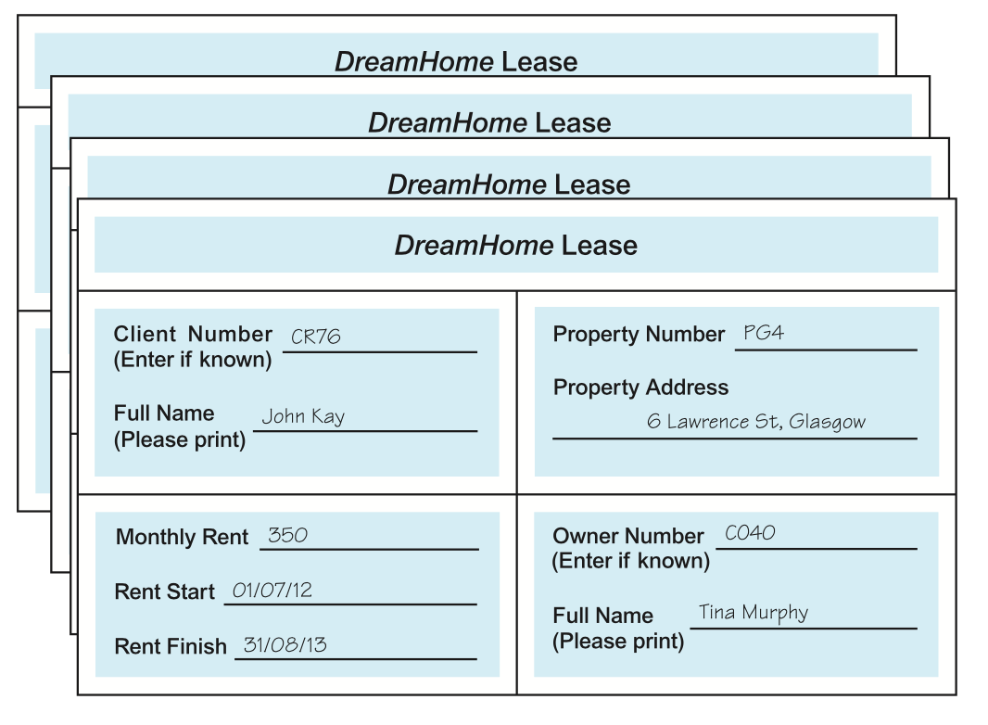
Example - First Normal Form (1NF)
Consider a collection of DreamHome lease shown below. For this example we assume that a client rents a given property only once and cannot rent more than one property at any one time.

Slide 8
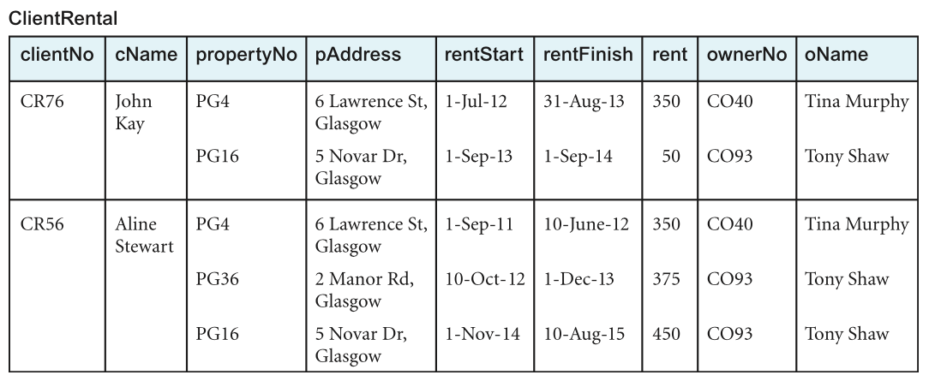
Example - First Normal Form (1NF)
Assuming sample data is taken from two leases for two different clients called John Kay and Aline Stewart and is transformed into table format with rows and columns, as shown in below
This is an example of an unnormalized table.

Slide 9
Example - First Normal Form (1NF)
First, from the UNF, we can identify the key attributes as clientNo.
Next, we identify the repeating group in the unrealized table as the property rented details, which repeats for each client. The structure of the repeating group is:
Repeating Group = (propertyNo, pAddress, rentStart, rentFinish, rent, ownerNo, oName)
As there are multiple values at the intersection of certain rows and columns.(e.g. there are two values for propertyNo (PG4 and PG16) for the client named John Kay). To transform an unnormalized table into 1NF, we ensure that there is a single value at the intersection of each row and column. This is achieved by removing the repeating group.

Slide 10
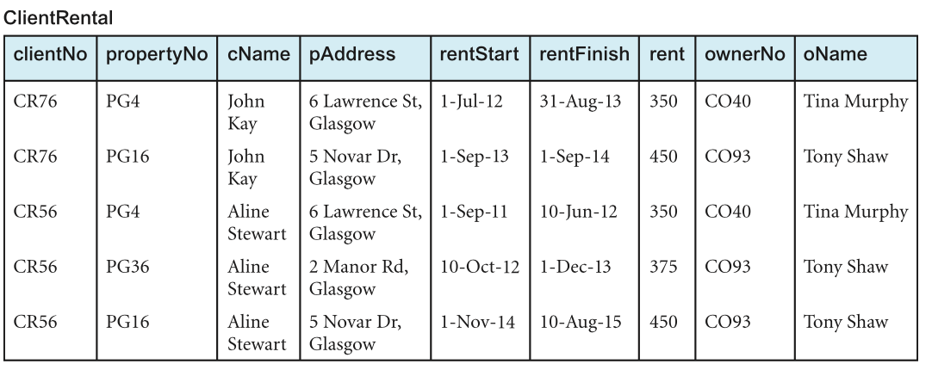
Example - First Normal Form (1NF)
Using the first approach, we arrive at the first normal form ClientRental relation by removing the repeating group (property rented details) by entering the appropriate client data into each row.

Slide 11
Example - First Normal Form (1NF)
Using the functional dependencies discussed earlier, we can identify candidate keys for the ClientRental relation as being composite keys comprising (clientNo, propertyNo), (clientNo, rentStart), and (propertyNo, rentStart).
Using (clientNo, propertyNo) as the primary key for the relation, and for clarity we place the attributes that make up the primary key together at the left-hand side of the relation. In this example, we assume that the rentFinish attribute is not appropriate as a component of a candidate key as it may contain nulls.

Slide 12
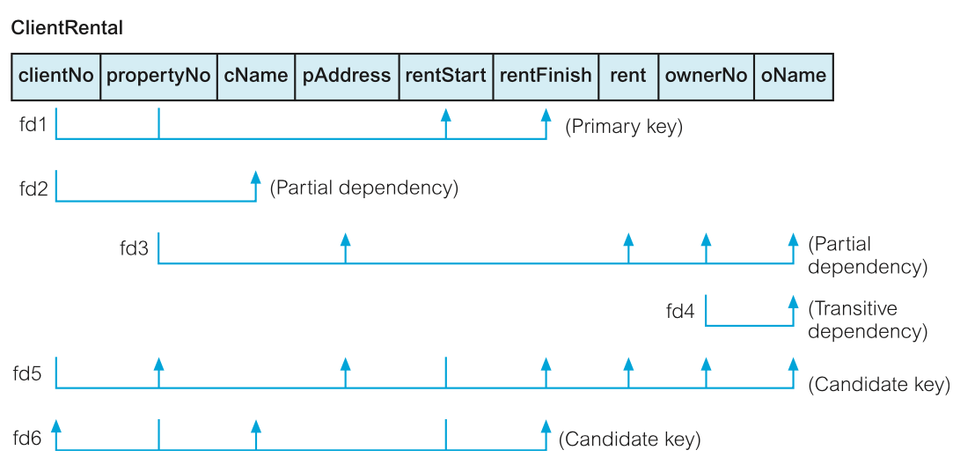
Example - First Normal Form (1NF)

Slide 13
Example - First Normal Form (1NF)
The ClientRental relation is defined as follows:
ClientRental (clientNo, propertyNo, cName, pAddress, rentStart, rentFinish, rent, ownerNo, oName)
The ClientRental relation is in 1NF, as there is a single value at the intersection of each row and column. The relation contains significant data redundancy as data describing clients, property rented, and property owners, is repeated several times. This 1NF would be subjected to update anomalies if implemented. Transforming the relation into second normal would remove some.

Slide 14
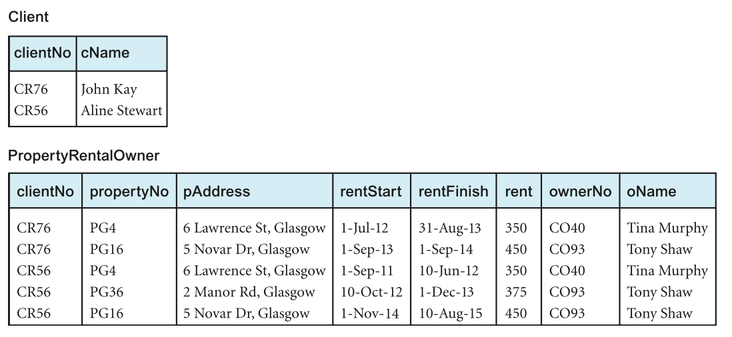
Example - First Normal Form (1NF)
Using the second approach, we remove the repeating group (property rented details) by placing the repeating data along with a copy of the original key attribute (clientNo) in a separate relation

Slide 15
Example - First Normal Form (1NF)
With the help of the functional dependencies identified previously we identify a primary key for the relations. The format of the resulting 1NF relations are as follows:
Client (clientNo, cName) PropertyRentalOwner (clientNo, propertyNo, pAddress, rentStart, rentFinish, rent, ownerNo, oName)

Slide 16
Example - First Normal Form (1NF)
The Client and PropertyRentalOwner relations are both in 1NF, as there is a single value at the intersection of each row and column. The Client relation contains data describing clients and the PropertyRentalOwner relation contains data describing property rented by clients and property owners.
However, this relation also contains some redundancy and as a result may suffer from similar update anomalies.

Slide 17
Second Normal Form (2NF)
Is a relation that is in first normal form and every non-primary-key attribute is fully functionally dependent on the primary key.
The normalisation of 1NF relations to 2NF involves the removal of partial dependencies. If a partial dependency exists, we remove the partially dependent attribute(s) from the relation by placing them in a new relation along with a copy of their determinant.

Slide 18
Second Normal Form (2NF)
To demonstrate the process of normalising relations from 1NF to 2NF, we would use only the ClientRental relation. However, recall that both approaches are correct, and will ultimately result in the production of the same relations as we continue the process of normalization.

Slide 19
Example - Second Normal Form (2NF)
Recalling that the ClientRental relation has the following functional dependencies:
fd1 clientNo, propertyNo ® rentStart, rentFinish (Primary key)
fd2 clientNo ® cName (Partial dependency)
fd3 propertyNo ® pAddress, rent, ownerNo, oName (Partial dependency)
fd4 ownerNo ® oName (Transitive dependency)
fd5 clientNo, rentStart ® propertyNo, pAddress, (Candidate key)
rentFinish, rent, ownerNo, oName
fd6 propertyNo, rentStart ® clientNo, cName, (Candidate key)
rentFinish

Slide 20
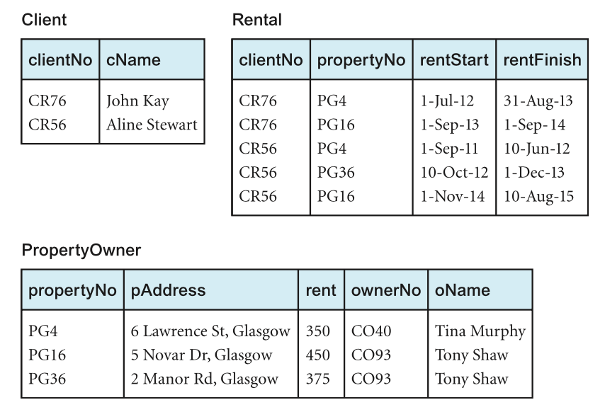
Example - Second Normal Form (2NF)

Slide 21
Example - Second Normal Form (2NF)
Using these functional dependencies, we continue the process of normalizing the ClientRental relation.
We start by testing whether the ClientRental relation is in 2NF by identifying the presence of any partial dependencies on the primary key.
We note that the client attribute (cName) is partially dependent on the primary key, in other words, on only the clientNo attribute (represented as fd2).

Slide 22
Example - Second Normal Form (2NF)
The property attributes (pAddress, rent, ownerNo, oName) are partially dependent on the primary key, that is, on only the propertyNo attribute (represented as fd3).
The property rented attributes (rentStart and rentFinish) are fully dependent on the whole primary key; that is the clientNo and propertyNo attributes (represented as fd1).

Slide 23
Example - Second Normal Form (2NF)
Identification of partial dependencies within the ClientRental relation indicates that the relation is not in 2NF.
To transform the ClientRental relation into 2NF requires the creation of new relations so that the non-primary-key attributes are removed along with a copy of the part of the primary key on which they are fully functionally dependent.

Slide 24
Example - Second Normal Form (2NF)
This results in the creation of three new relations called Client, Rental, and PropertyOwner. These three relations are in second normal form, as every non-primary-key attribute is fully functionally dependent on the primary key of the relation.
Client (clientNo, cName) Rental (clientNo, propertyNo, rentStart, rentFinish)
PropertyOwner (propertyNo, pAddress, rent, ownerNo, oName)

Slide 25
Third Normal Form (3NF)
Is a relation that is in first and second normal form in which non-primary-key attribute is transitively dependent on the primary key.
The normalization of 2NF relations to 3NF requires updating two tuples in the relation. If only one tuple is updated and not the other, the database would be in an inconsistent state.
This anomaly is caused by a transitive dependency, we need to remove such dependencies by progressing to third normal form.
The normalization of 2NF relations to 3NF involves the removal of transitive dependencies. If a transitive dependency exists, we remove the transitively dependent attribute(s) from the relation by placing them in a new relation along with a copy of their determinant.

Slide 26
Example - Third Normal Form (3NF)
Recalling that the Client, Rental and propertyOwner relation has the following functional dependencies:
Client fd2 clientNo ® cName (Primary key)
Rental fd1 clientNo, propertyNo ® rentStart, rentFinish (Primary key)
fd5' clientNo, rentStart ® propertyNo, rentFinish (Candidate key)
fd6' propertyNo, rentStart ® clientNo, rentFinish (Candidate key)
PropertyOwner
fd3 propertyNo ® pAddress, rent, ownerNo, oName (Primary key)
fd4 ownerNo ® oName (Transitive dependency)

Slide 27
Example - Third Normal Form (3NF)
All non-primary-key attributes in Client and Rental relations are functionally dependent on only their primary keys. They have no transitive dependencies and therefore already 3NF.
Like in Client and Rental relations, all non-primary-key attributes in PropertyOwner relation are functionally dependent on the primary key, with the exception of oName, which transitively dependent on ownerNo.
Transforming the PropertyOwner relation into 3NF, we must first remove the transitive dependency.
This is done by creating 2 new relations;
PropertyForRent
Owner
PropertyForRent (propertyNo, pAddress, rent, ownerNo)
Owner (ownerNo, oName)

Slide 28
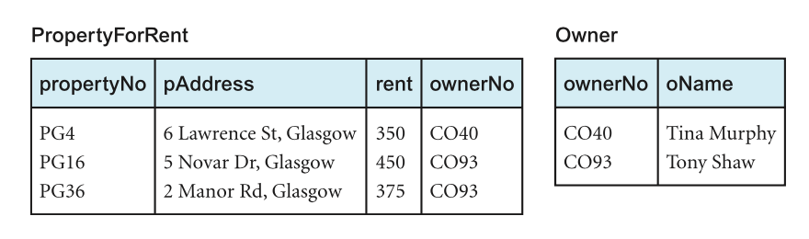
Example - Third Normal Form (3NF)
This are in 3NF and there’s no further transitive dependency on the primary key

Slide 29
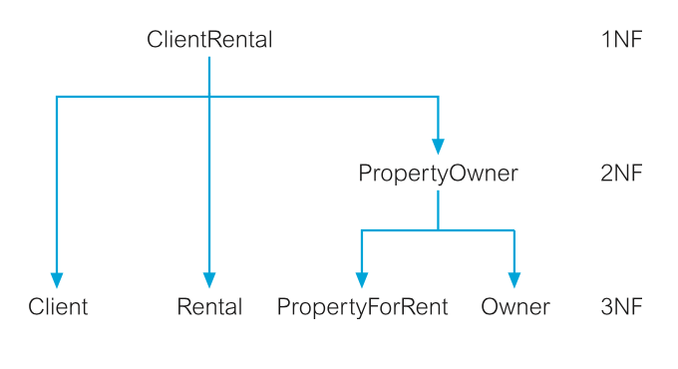
Example - Third Normal Form (3NF)
Using the process of normalisation, the ClientRental relation introduced in slide 48 has been transformed into a 3NF.
The resulting 3NF relation as shown above have the form
Client (clientNo, cName) Rental (clientNo, propertyNo, rentStart, rentFinish)
PropertyForRent (propertyNo, pAddress, rent, ownerNo)
Owner (ownerNo, oName)

Slide 30
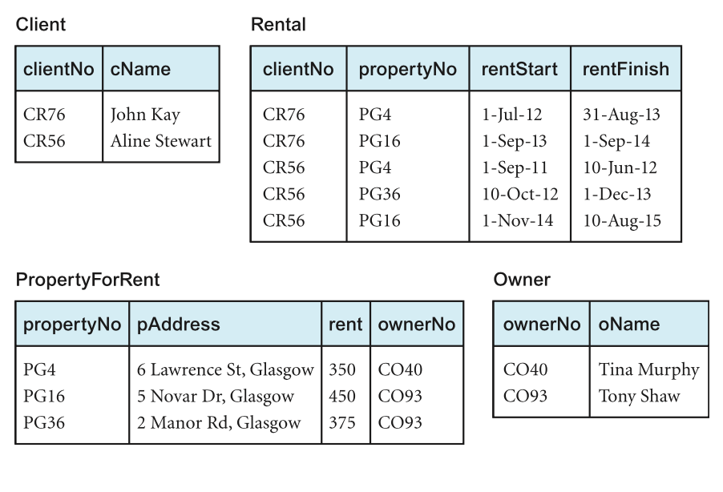
Example - Third Normal Form (3NF)

Slide 31
Natural Join Operation
The original ClientRental relation can be recreated by joining the Client, Rental, PropertyForRent, and Owner through the primary key/foreign mechanism.
The ownerNo attribute is a primary key within the Owner relation and is also present within the PropertyForRent relation as a foreign key.
The ownerNo attribute acting as a primary key/foreign key allows the association of the PropertyForRent and Owner relations to identify the name of property owners.

Slide 32
Natural Join Operation
The clientNo attribute is a primary key of the Client relation and is also present within the Rental relation as a foreign key. Note that in this case the clientNo attribute in the Rental relation acts both as a foreign key and as part of the primary key of this relation.
The propertyNo attribute is the primary key of the PropertyForRent relation and is also present within the Rental relation acting both as a foreign key and as part of the primary key for this relation.

Slide 33
Summary
We have demonstrated how normalization can be used to decompose original relation using series of relational algebra projections.
This results in a lossless-join decomposition, which is reversible using natural join operation.

